Slide 1
Cottage Housing
Planning Commission Briefing April 25, 2024

Slide 2
Presentation Outline
Background and context
Examples of cottage housing
Policy questions
Next steps

Slide 3
Comprehensive Plan direction 1
L.U. 5.4 - Explore the creation of a new Planned Unit Development zoning district focused on unique and flexible mixed residential development.

Slide 4
Comprehensive Plan direction 2
H.O. 1.2 – Review regulations allowing accessory dwelling units in separate structures in appropriate residential areas

Slide 5
Comprehensive Plan direction 3
H.O. 5.3 - Explore modifying the City's zoning regulations to facilitate the creation of a variety of safe, affordable, and innovative housing options, including the establishment of small lot, attached units, and other housing types that achieve higher densities and a diversity of housing options.

Slide 6
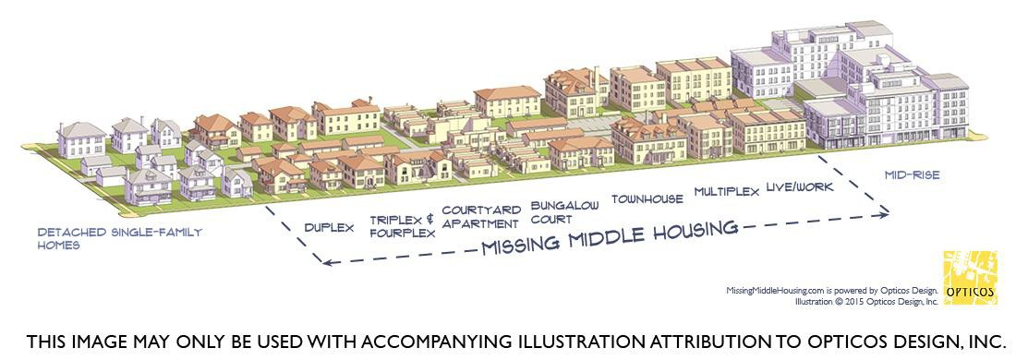
Missing Middle Housing
Missing Middle is a range of multi-unit or clustered housing types compatible in scale with single-family homes that help meet the growing demand for walkable urban living.

Slide 7
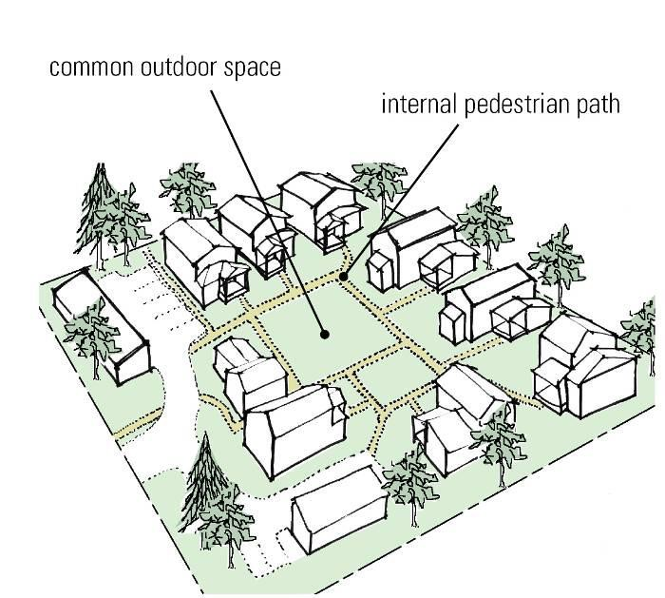
What is Cottage Housing?
A grouping of small, single family dwelling units clustered around a common area.
Opticos Design, Inc.

Slide 8
Characteristics
Increased density
Smaller units
Shared common area
Shared ownership
Corral the car
Connected internal paths
Porches facing the commons
Layer spaces from public to private

Slide 9
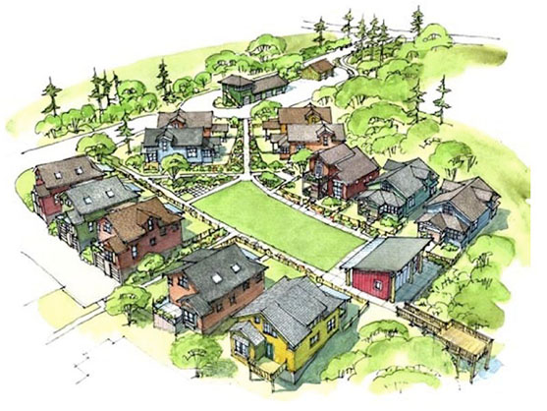
Project: Conover Commons Architect: Ross Chapin Architects Developer: The Cottage Company

Slide 10
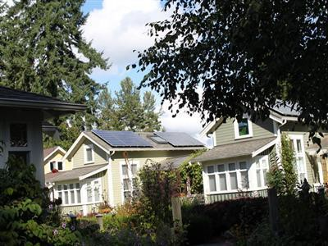
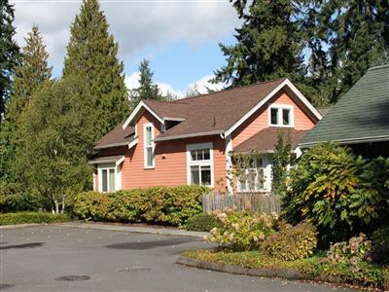
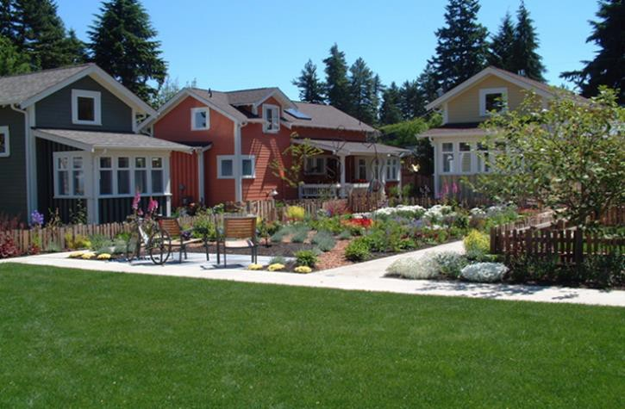
GREENWOOD
City of Shoreline
Average Unit Size 961 square feet Detached garages
The Cottage Company
Photo Courtesy of The Cottage Company

Slide 11
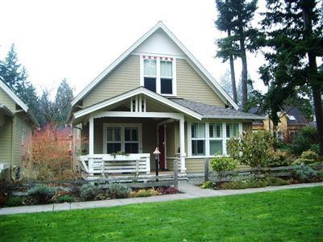
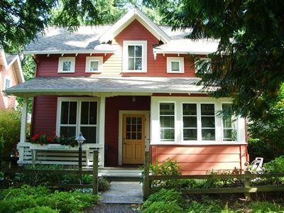
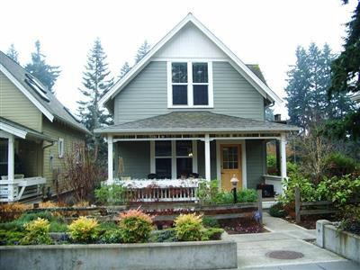
DANIELSON GROVE
City of Kirkland
Unit size 1500-1700 ft² Detached garages
The Cottage Company

Slide 12
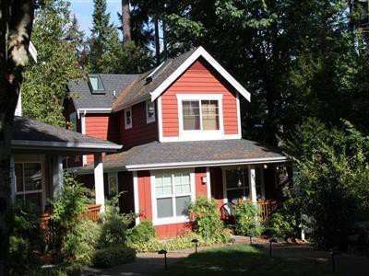
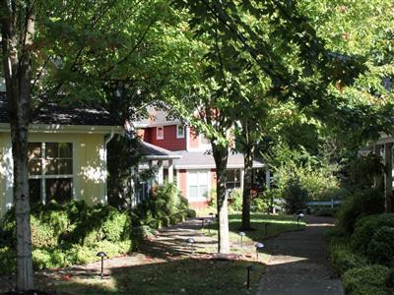
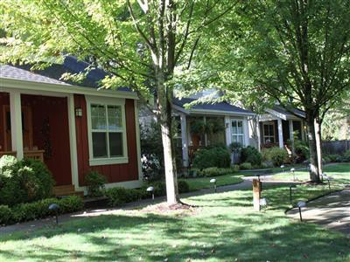
MADRONA COTTAGES
City of Shoreline Average Unit Size 990 ft² Detached garage

Slide 13
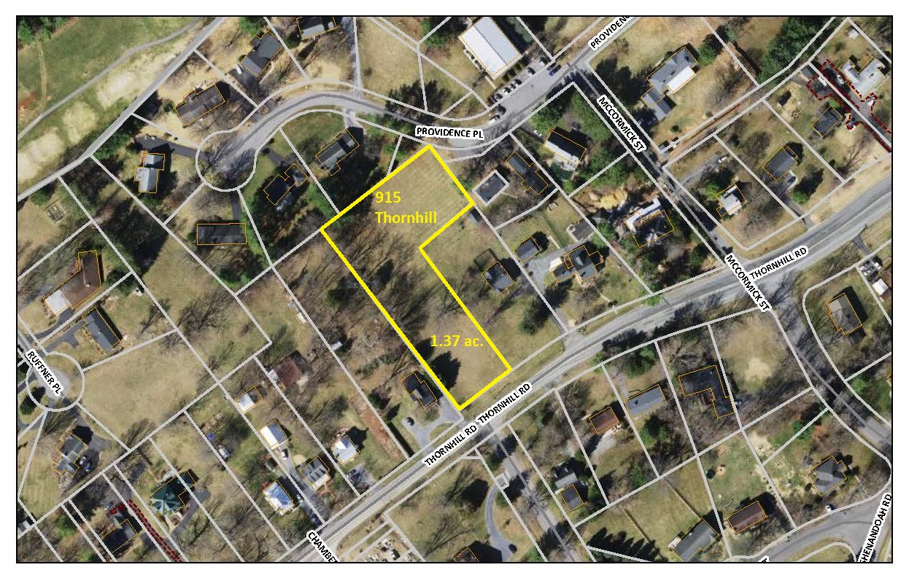
Local Example

Slide 14
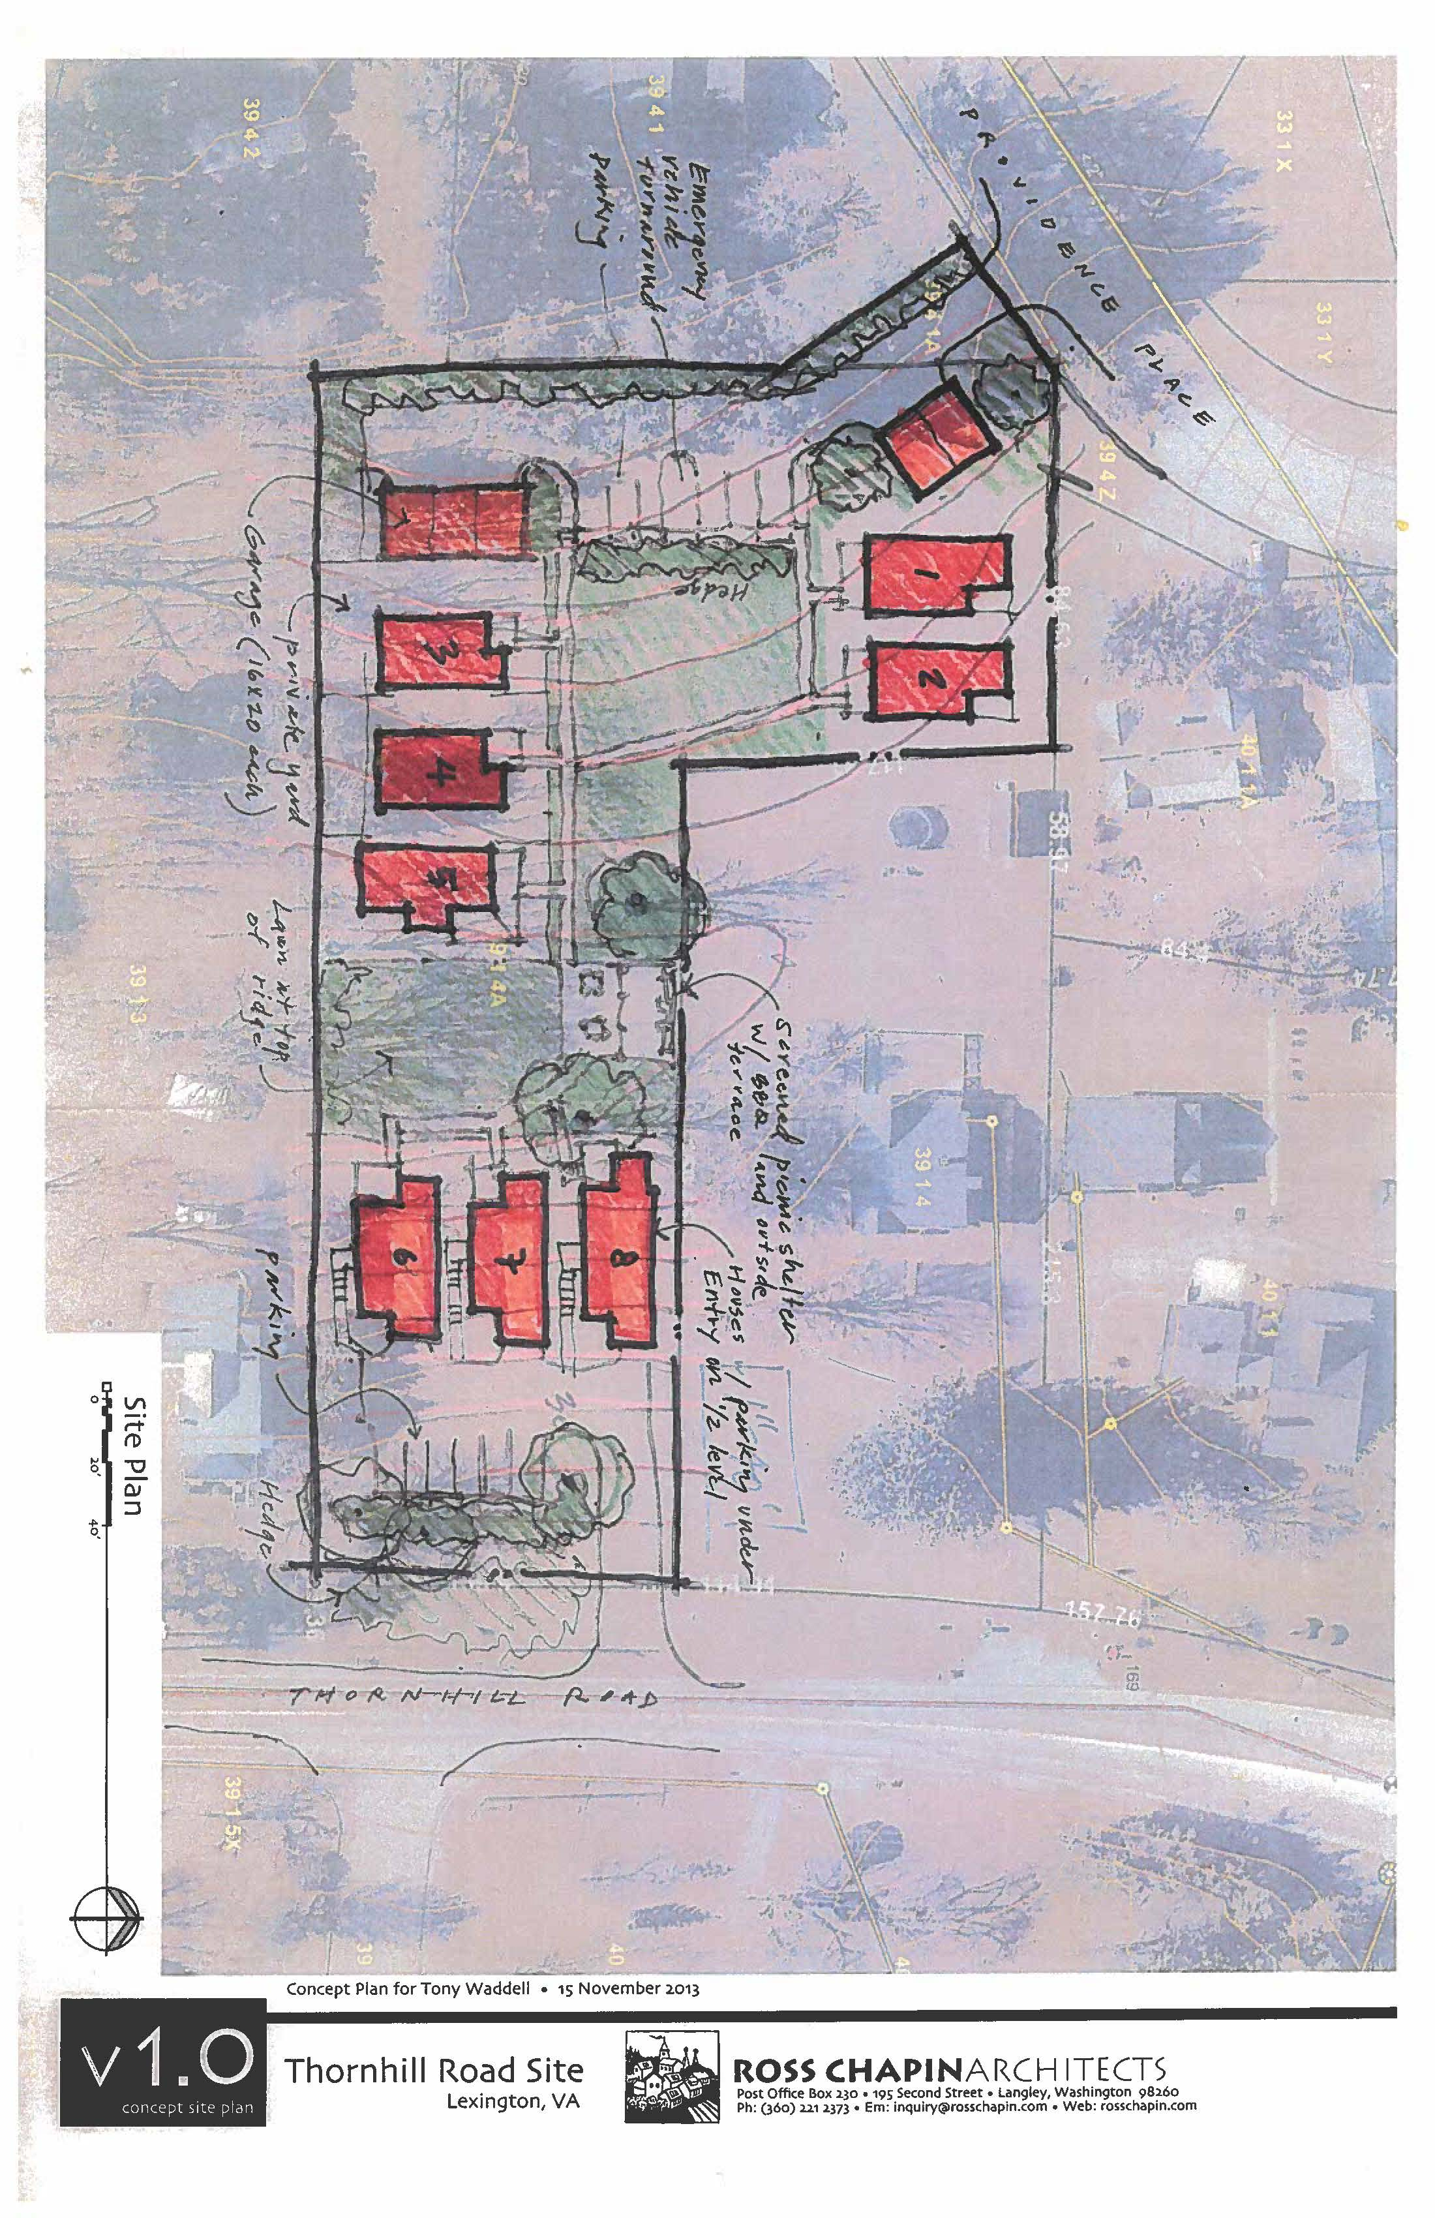

Slide 15
Benefits
Increase housing supply
Increase housing variety
Increase housing affordability
Increased sense of community

Slide 16
Policy Questions
What should the maximum size of the dwelling unit be?
Parking: How much? Where located? Attached? Detached? Carports? Surface lot?
To what degree should the cottage design be regulated?
How should cottage housing projects fit with other single family development?

Slide 17
Next steps

Slide 18
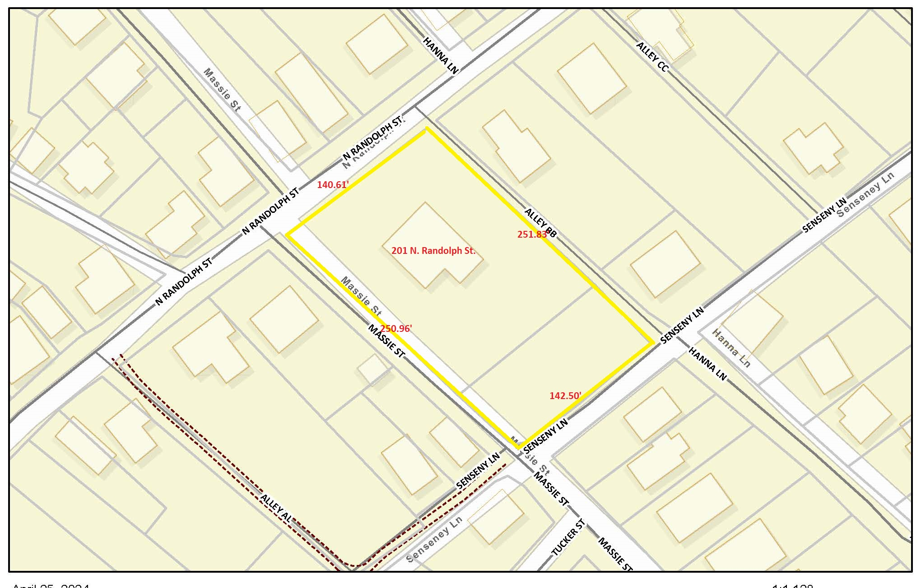

Slide 19
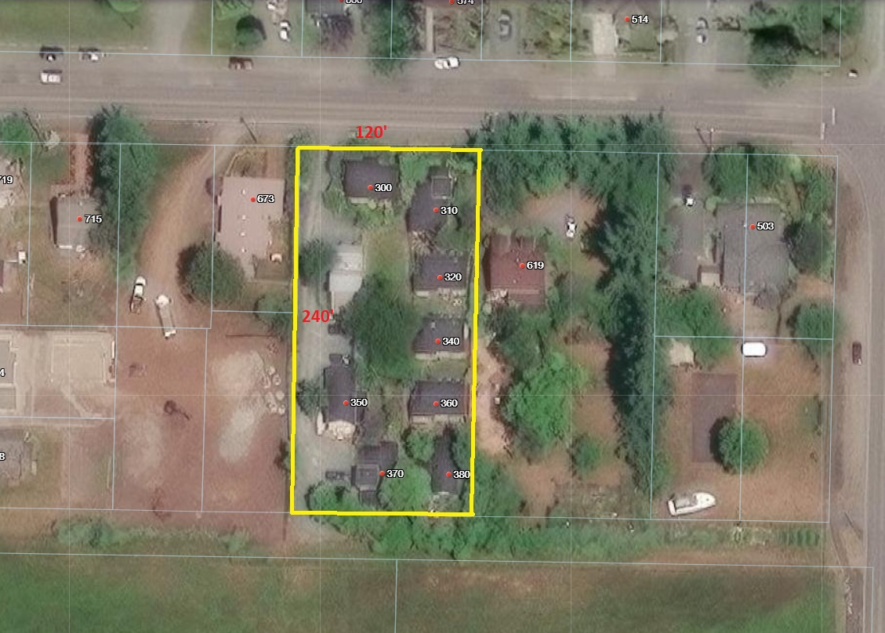

Slide 20
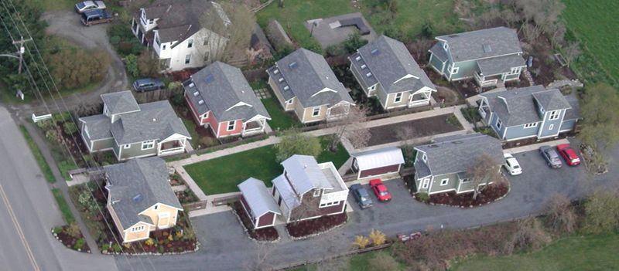

Slide 21
